Slide 1
Management & Organisational Behaviour 4
Module Code: ENGE08016

Slide 2
Organizational Lifecycle

Slide 3
Learning Objective
Explain the challenges of large organization size.
Describe how an organization progresses through four stages of the organizational life cycle.
Define the characteristics of bureaucracy.
Compare large organizations and small organizations along the dimensions of formalization, centralization, and personnel ratios.
Identify approaches to reducing bureaucracy in large organizations.
Contrast market and clan control with bureaucratic control.
Describe the model of decline stages.

Slide 4

Organization Size
Pressures for Growth
Every entrepreneur wants the company grow fast and large however, some companies that have resisted the pressure for endless growth and focused on different goals.
Industry consolidation, global expansion, and diversification have made firms grow
Organizations strive for growth to acquire the size and resources needed for global competition, to invest in new technology, and to control distribution channels
Despite the proliferation of new, small organizations, giants such as Toyota and Walmart continue to grow. To stop growing is to stagnate.
Customers may not have their demands fully met or that competitors will increase market share.
Image Source: Google

Slide 5

Organization Size
Dilemmas of Organization Size
Large organizations are better able to weather economic downturns and can get back to business more quickly following a disaster
Small companies are flexible and responsive, with a flat structure and an organic, free-flowing management style
Big-company/small-company hybrids” combine a large corporation’s resources and reach with a small company’s simplicity and flexibility
Image Source: Google

Slide 6
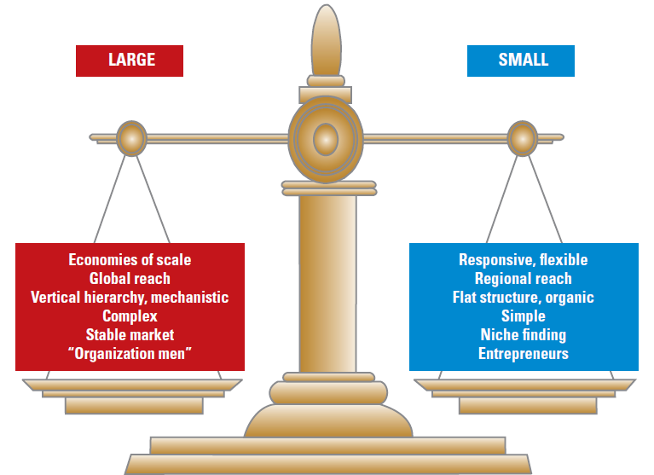
Organization Size
Dilemmas of Organization Size
Differences between large versus small size are summarized in the figure on the right.
Huge resources and economies of scale are needed for many organizations to compete globally with products such as wind turbines.
Large companies are standardized, often mechanistically run, and complex.
The argument for small size stems from the need for
responsiveness and flexibility in fast-changing markets. The Internet has made it easier for small companies to compete with larger firms. Small organizations have a flat structure and an organic, free-flowing management style that encourages entrepreneurship and innovation.
Image Source: Cengage Learning

Slide 7
Organization Size
Dilemmas of Organization Size
Big-Company/Small-Company Hybrid
Many small organizations can become victims of their own success as they grow large, shifting to a mechanistic structure and failing to reward an entrepreneurial approach.
A big-company/small-company hybrid is the solution. Large companies can retain flexibility and customer-focus by decentralizing authority, cutting out layers of the hierarchy, and using information technology.
Image Source: Cengage Learning

Slide 8

Organization Size
Dilemmas of Organization Size
Dell was once the top PC maker in the world. Now It faces stiff competition.
As it transitions from a PC company to a “solutions company,” it is trying to return to its entrepreneurial roots.
Dell is moving into cybersecurity and data center design and management, and letting those units operate more autonomously.
Michael Dell says he wants the units to act more creatively and less bureaucratically so he is taking a hands-off approach
Image Source: Dell

Slide 9
Stages of Life Cycle Development
An organizational life cycle suggests that organizations are born, grow older, and eventually die. Organization structure, leadership style, and administrative systems follow a fairly predictable pattern through stages in the life cycle. Whenever an organization enters a new stage in its life cycle, a new set of rules emerges for how the organization functions internally and how it relates to its environment.
Entrepreneurial stage. Emphasis is on creating a product or service and surviving. The founders devote their energies to production and marketing. Creative and technically-oriented owners are confronted with management issues.
Collectivity stage. Known for development of clear goals and direction, followed by an autonomy crisis as managers want more freedom.
Formalization stage. Known for the addition of internal systems, followed by a crisis of needing to deal with too much red tape.
Elaboration stage. A mature organization, known for development of teamwork through manager teams and task forces, often across divisions of the company, sometimes including periods of temporary decline in which there is a crisis of the need for revitalization.
Eighty-four percent of businesses that make it past the first year fail within five years because they can’t make the transition from the entrepreneurial stage.

Slide 10
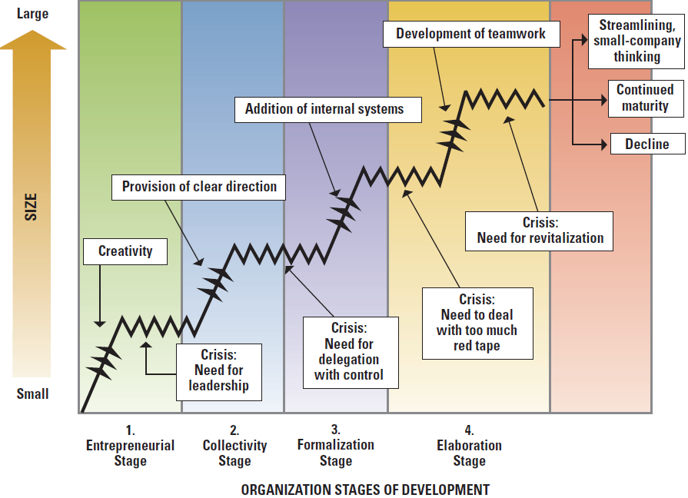
Stages of Life Cycle Development
Image Source: Cengage Learning

Slide 11
Stages of Life Cycle Development
Organizational Characteristics During the Life Cycle
Entrepreneurial stage. Organization is small, non-bureaucratic, and a one person show. The top manager provides the structure and control system. Rewards are personal.
Collectivity stage. Growth is rapid, and employees are excited and committed. The structure is still informal, although some procedures are emerging. Strong charismatic leaders provide direction. Continued growth is a major goal.
Formalization stage. The organization adds staff support groups, formalizes procedures, and a hierarchy and division of labor. Innovation is achieved by a separate (R&D) department. Goals are stability and expansion. Management delegates, but implements formal control systems.
Elaboration stage. The organization is large and bureaucratic, with extensive control systems, rules, and procedures. Managers develop a team orientation to prevent further bureaucratization.

Slide 12
Stages of Life Cycle Development
Organization Characteristics During Four Stages of Life Cycle
 | 1. Entrepreneurial | 2. Collectivity | 3. Formalization | 4. Elaboration
Characteristic | Nonbureaucratic | Pre-bureaucratic | Bureaucratic | Very Bureaucratic
Structure | Informal, one-person show | Mostly informal, some procedures | Formal procedures, division of labor, new specialties added | Teamwork within bureaucracy, small-company thinking
Products or services | Single product or service | Major product or service, with variations | Line of products or services | Multiple product or service lines
Reward and control systems | Personal, paternalistic | Personal, contribution to success | Impersonal, formalized systems | Extensive, tailored to product and department
Innovation | By owner-manager | By employees and managers | By separate innovation group | By institutionalized R&D department
Goal | Survival | Growth | Internal stability, market expansion | Reputation, complete organization
Top management style | Individualistic, entrepreneurial | Charismatic, direction-giving | Delegation with control | Team approach, attack bureaucracy

Slide 13
What is Bureaucracy?
Sociologist Max Weber defined bureaucracy as a threat to personal liberties but the most efficient possible system for organizing.
A bureaucratic organization is a government agency or commercial business with a heavily enforced chain of command and tightly regulated operating procedures. It's an administrative system that relies on policies, rules and hierarchy in both public and private sector environments.
Six characteristics of bureaucracy include:
Rules and procedures
Specialization and division of labor
Hierarchy of authority
Technically qualified personnel
Separation of position and position holder
Written communication and records

Slide 14
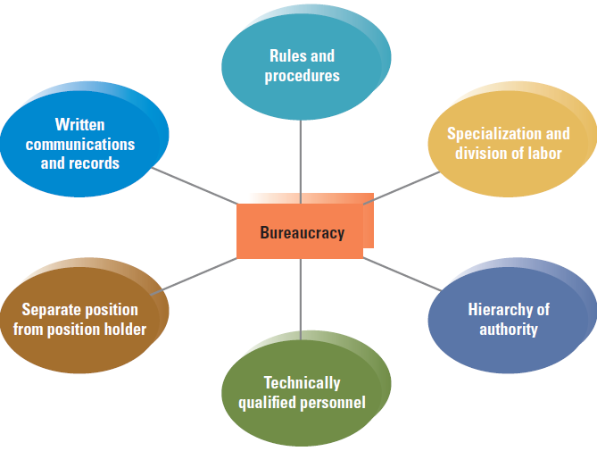
Weber’s Dimensions of Bureaucracy
Image Source: Cengage Learning

Slide 15

Bureaucratic Organization
UPS became very efficient through adoption of the bureaucratic model of organization.
Despite the strict rules, employees are satisfied, and UPS has a high retention rate because employees are treated well and paid well.
Everyone is on a first-name basis and the company promotes from within based on merit.
The emphasis on equality, fairness, and a promote-from-within mentality inspires loyalty and commitment throughout the ranks
Image Source: UPS

Slide 16
Size and Structural Control
Formalization:
Large organizations have greater formalization, referring to rules, procedures, and written documentation. Large organizations rely on rules to achieve standardization and control across their large numbers of employees and departments.
Centralization:
Refers to the level of hierarchy with authority to make decisions. In centralized organizations, decisions tend to be made at the top. However, due to their size and complexity, larger organizations must allow decision-making at lower levels, known as decentralization.
Personnel ratios:
Personnel Rations for administrative, clerical, and professional support staff differ in large versus small organizations. As organizations increase in size, the administrative ratio declines and the ratios for other support groups increase. Keeping costs for administrative, clerical, and professional support staff low represents an ongoing challenge for large organizations.

Slide 17
Bureaucracy in a Changing World
As Weber predicted, bureaucracy met the needs of the industrial age very well. But today, with rapid environmental changes, machine-like bureaucracy may not function as well.
Many business organizations need to reduce formalization and bureaucracy.
Narrowly defined job descriptions and excessive rules limit the creativity, flexibility, and rapid response needed in today’s knowledge-based organizations.
Steps that organizations can take to reduce bureaucracy include:
Cutting layers of the hierarchy
Keeping headquarters staff small
Giving lower-level employees greater freedom to make decisions without excessive rules and regulations
Leveraging their employees’ professionalism (formal training and experience)
Providing on-going training to employees

Slide 18
Bureaucracy and Other Forms of Control
Three control strategies that organizations can adopt are
Bureaucratic Control
Market Control
Clan Control
Each form of control uses different types of information, but all three types may appear simultaneously in an organization
Type | Requirements
Bureaucratic | Rules, standards, hierarchy, legitimate authority
Market | Prices, competition, exchange relationship
Clan | Tradition, shared values and beliefs, trust

Slide 19
Bureaucracy and Other Forms of Control
Bureaucratic control is the use of rules, regulations, policies, hierarchy, documentation, and other bureaucratic mechanisms to standardize behavior and assess performance. Some bureaucratic control is used in almost every organization. Bases of control include rational-legal authority--based on employees’ belief in the legality of rules and the right of those elevated to positions of authority to issue commands; traditional authority belief in traditions and in the legitimacy of the status of people exercising authority through tradition; charismatic authority based on devotion to the exemplary character or heroism of an individual person and the order he or she defines. Management control systems are the formalized routines, reports, and procedures that use information to maintain or alter patterns in organizational activity.
Market control uses price-cost comparisons to evaluate performance. Market control requires price competition so that the price reflects the true value of outputs and is a measure of internal efficiency. It is used primarily at the level of the entire organization, but can also be used in product divisions or profit centers. The network organization illustrates market control.

Slide 20
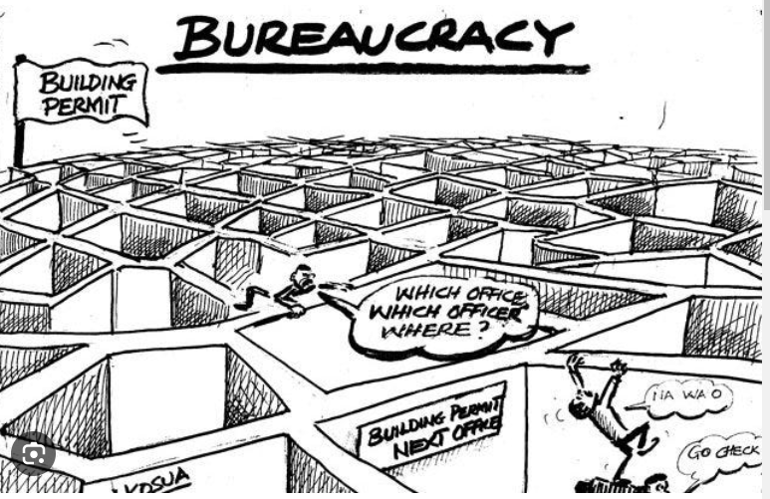
Bureaucracy and Other Forms of Control
Clan control is the use of corporate culture, shared values, commitment, traditions, trust, and beliefs to control behavior. People behave the way the culture expects because they are part of the group and want to belong. It is used in organizations with a strong culture, because of personal involvement in and commitment to the organization's purpose. Clan control is important when ambiguity and uncertainty are high. Managers act as mentors, role models, and agents for transmitting values.
Image Source: ehab-badwi.medium

Slide 21

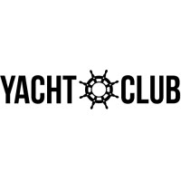

Examples of Rules at a Yacht Club
Employees shall maintain a clean and well-dressed appearance at work.
The summer uniform is green shorts, black or brown belt, white shirt tucked in, and boat shoes. Frayed clothing is not allowed at the club.
Employees should arrive at work at or before the agreed-upon shift time.
Employees shall not smoke or consume alcohol on club property at any time.
Employees are required to be polite and helpful to members at all times.
Employees should remain a respectful distance from members and should not accept social invitations from members.
Employees should not be on club property when they are not working.
Employees are not permitted to use the club phones to make or receive personal calls.
Instructors must provide their own manuals and radio.
Maintenance employees must provide and use their own tools.
Images Source: Google

Slide 22

Organizational Decline
Organizational decline is the decrease of an organization’s resources over time and is caused by:
Organizational atrophy occurs when organizations become inefficient and overly bureaucratized. Their ability to adapt to the environment deteriorates.
Vulnerability reflects an organization’s strategic inability to prosper in its environment.
Environmental decline or competition refers to reduced energy and resources available to support an organization.
Images Source: HR C-Suite

Slide 23
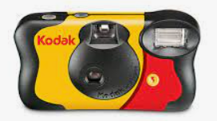
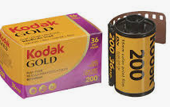
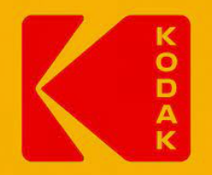
Kodak - Organizational Decline
The ignorance of new technology and not adapting to changing market needs initiated Kodak's downfall
Kodak invested its funds in acquiring many small companies, depleting the money it could have used to promote the sales of digital cameras.
Kodak wasted time promoting the use of film cameras instead of emulating its competitors. It completely ignored the feedback from the media and the market
When Kodak finally understood and started the sales and the production of digital cameras, it was too late. Many big companies had already established themselves in the market by then and Kodak couldn't keep pace with the big shots
In September 2011, the stock prices of Kodak hit an all-time low of $0.54 per share
Kodak declared bankruptcy in 2012
Images Source: Kodak

Slide 24
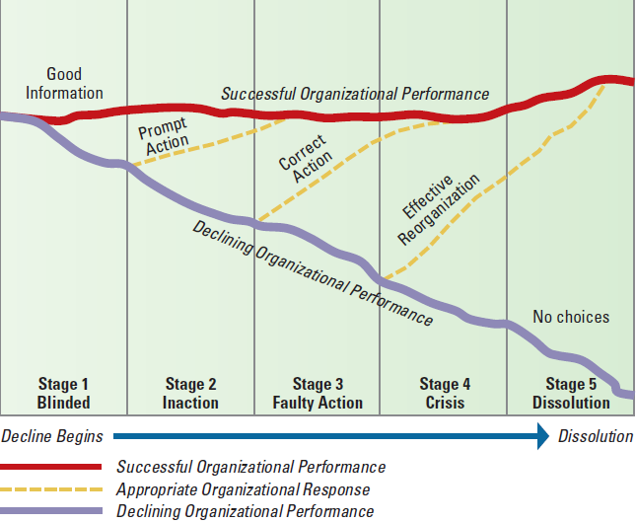
Five Stages of Organizational Decline
Image Source: Cengage Learning

Slide 25
Five Stages of Organizational Decline
The five stages of organizational decline are presented in this model.
Blinded stage. This is the internal and external change that threatens long-term survival and might require the organization to tighten up.
Inaction stage. Denial occurs despite signs of deteriorating performance.
Faulty action stage. During this stage, the company tries to take action, but it is not the correct action.
Crisis stage. The organization experiences chaos, may go back to basics, and experiences panic and anger.
Dissolution stage. The organization is forced to close down in an orderly fashion.
Image Source: Cengage Learning

Slide 26
Organizational Design Essentials
Organizations experience many pressures to grow, and large size is crucial to economic health in some industries.
Organizations evolve through distinct life-cycle stages as they grow and mature.
As organizations progress through the life cycle and grow larger and more complex, they generally take on bureaucratic characteristics.
In many large organizations, bureaucracy has come under attack with attempts to decentralize authority, flatten organization structure, reduce rules and written procedures, and create a small-company mindset.
All organizations, large and small, need systems for control, and managers may use a combination of control approaches to meet the organization’s needs.
It is the responsibility of managers to detect the signs of decline, implement necessary action, and reverse course.

Slide 27
Learning Objectives Completed
Explain the advantages and disadvantages of large organization size.
Describe how an organization progresses through four stages of the organizational life cycle.
Define the characteristics of bureaucracy.
Compare large organizations and small organizations along the dimensions of formalization, centralization, and personnel ratios.
Identify approaches to reducing bureaucracy in large organizations.
Contrast market and clan control with bureaucratic control.
Describe the model of decline stages.

